Slide 1
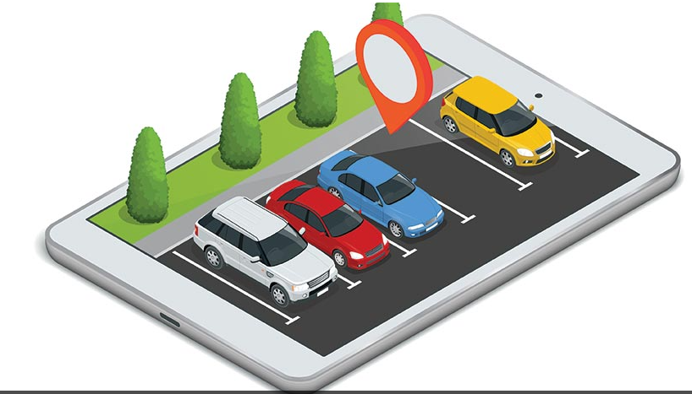
Smart Parking Space App Project
Student Name:
Course Title:
Institution Name:
Professor Name:

Slide 2
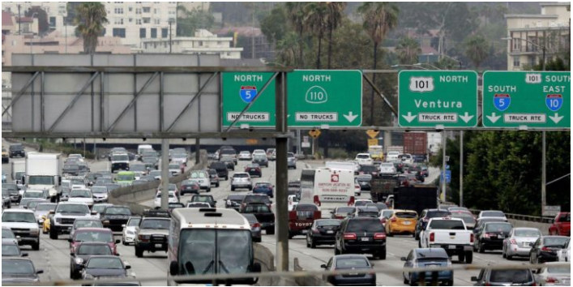
Rationale of the Project
City Administration focuses on improving people’s welfare
The Project is important to city’s administration in understanding the current state of traffic.
Current state of city traffic is time consuming.
Investment in Smart Parking Space App will help manage traffic in the city.
Notes:
City’s administration key objective is not to make revenue but to better the welfare of the population in the city. However, many cities in America are characterized with high traffic and congestion in the city during the day. Therefore, finding a parking lot in the city or the streets in the city is time consuming. This results to wastage of productive hours in the economy. So as to manage the city traffic, the city administration is planning to invest in a smart parking space app. To do this, there is need to analyze the existing data to better understand the current state of the traffic and parking. The results of the analysis will help achieve; the day of the week when the city has high occupancy rate and the relationship between occupancy rate and lotcode, and occupancy rate and timestamp Waheed, Shafi, & Krishna, 2020).

Slide 3
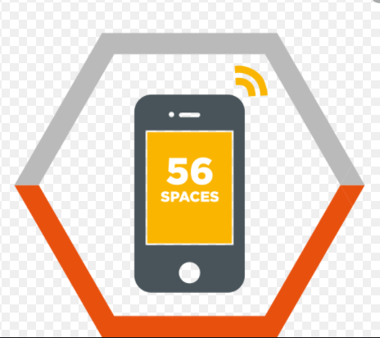
Goals of the Project
The goals of the project will achieve;
Current state of the traffic in the city.
Days of week with high occupancy rate.
The relationship between occupancy rate and time.
Notes:
Therefore, the project would aim to do an analysis on the current state of the traffic in the city, determining the occupancy rate throughout the week by considering the days with high occupancy and low occupancy to facilitate in the policy formulation. Additionally, it would be important to determine the relationship between the occupancy rate and time which would help in coming up with a very reliable policy.

Slide 4
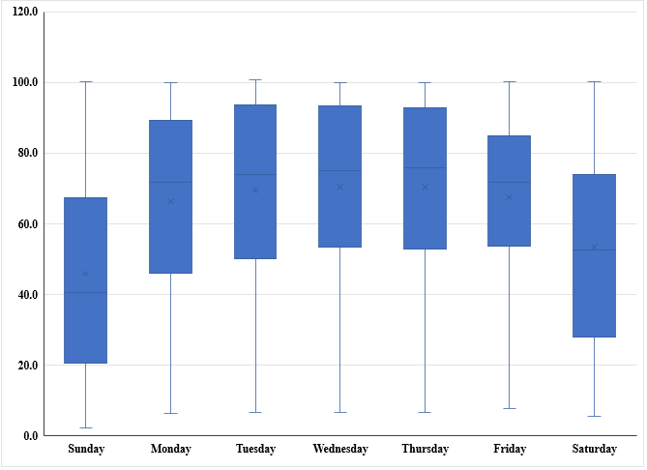
Box and Whisker Plot of Day and Occupancy Rate (%)
Median occupancy rate (%) is same on Tuesday, Wednesday, and Thursday.
Weekdays have high occupancy rate (employees).
Thursday has high occupancy rate followed by Wednesday.
Sunday has lowest occupancy rate; Sunday is an off work day.
Notes:
From the box and whisker plot, the median of the occupancy rate in the city s not the same through out the week. On Tuesday, Wednesday, and Thursday, the median occupancy rate is almost the same. On the other hand, the median of the occupancy rate is the same on Monday and on Friday. Sunday and Saturday have the lowest occupancy rate. This is expected since the Sunday and Saturday is an off work day. The occupancy rate is high during the weekdays. This is expected since most of the population are employees (Kumar et. al.)

Slide 5
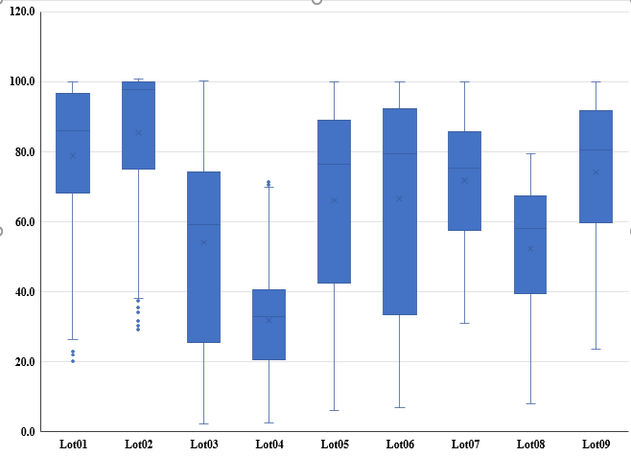
Box and Whisker Plot of LotCode and Occupancy Rate (%)
Lot2 has high median of occupancy rate.
Lot4 has the least median of occupancy rate.
Notes:
From the diagram, we can make the following conclusions; lot1 has the highest median of the occupancy rate (%), lot4 has the lowest median of occupancy rate. In addition, lot5, lot6, lot7, and lot9 have almost equal median of occupancy rate.

Slide 6
Occupancy Rate against Timestamp
(Lot01)
Notes:
The diagram depicts the following, high occupancy rate the during the morning hours and in the afternoon hours. Also, the figure indicates zero occupancy rate over the lunch hour of the day. This is expected since the most of the vehicles are parked in the morning hours, and in the afternoon hours. During the lunch hour, vehicles are in the move to either restaurants or others leaving work. Hence we can conclude that there is a relationship between occupancy rate and timestamp.

Slide 7
Cont.….
High concentration during morning hours.
High occupancy rate in the afternoon.
Low or no occupancy over lunch hour.
There is relationship between time and occupancy rate.

Slide 8
Occupancy Rate against Timestamp
(Lot07)
Notes:
From the scatter plot, the occupancy rate is high in the during the morning hours and in the afternoon hours. The plot indicates zero occupancy rate over the lunch hour of the day. This is expected since the most of the vehicles are parked in the morning hours, and in the afternoon hours. During the lunch hour, vehicles are in the move to either restaurants or others leaving work. In addition, the figure demonstrates a relationship between time and occupancy rate.

Slide 9
Cont..
High concentration during morning hours.
High occupancy rate in the afternoon.
Low or no occupancy over lunch hour.
There is a relationship between occupancy rate and time.

Slide 10
Conclusion
From the analysis above we can make the following conclusions;
Occupancy rate is high during morning hours and afternoon hours.
Occupancy during mid-day is zero.
Occupancy rate and time are related.
Notes:
From the analysis above we can make the following conclusions; Saturday and Sunday have high occupancy rate this is because most of the people who occupy the parking lot are employees. Since weekend is a off-day from work, most of the vehicles are parked at homes. On the other hand, since the weekdays people spend at work, the occupancy rate is high since the most vehicles are left at the parking lots. We also can conclude that the occupancy rate and time are related and the occupancy rate is between 6am and mid-day, and from 2pm to 6pm. During the lunch hour, the occupancy rate is almost zero.

Slide 11
Recommendation
Based on analysis conducted, I recommend an investment on smart parking space app.
Will reduce time spend looking for parking space.
The app manages collected revenue digitally.
Notes:
From the analysis above, I highly recommend an investment on smart parking space app. This will enable manage the parking in the city which will help the citizens use the time wasted when looking for parking spaces in the city. Also, The app will also help the city administration manage collected revenues digitally

Slide 12
References
Kumar, A. A., Ganesh, K., Jithish, S., Kumar, S. S., & Kalaikumaran, T. Smart Parking System.
Waheed, A., Shafi, J., & Krishna, P. V. (2020). Analyzing Significant Reduction in Traffic by Using Restricted Smart Parking. In Emerging Research in Data Engineering Systems and Computer Communications (pp. 27-40). Springer, Singapore.

